Slide 1
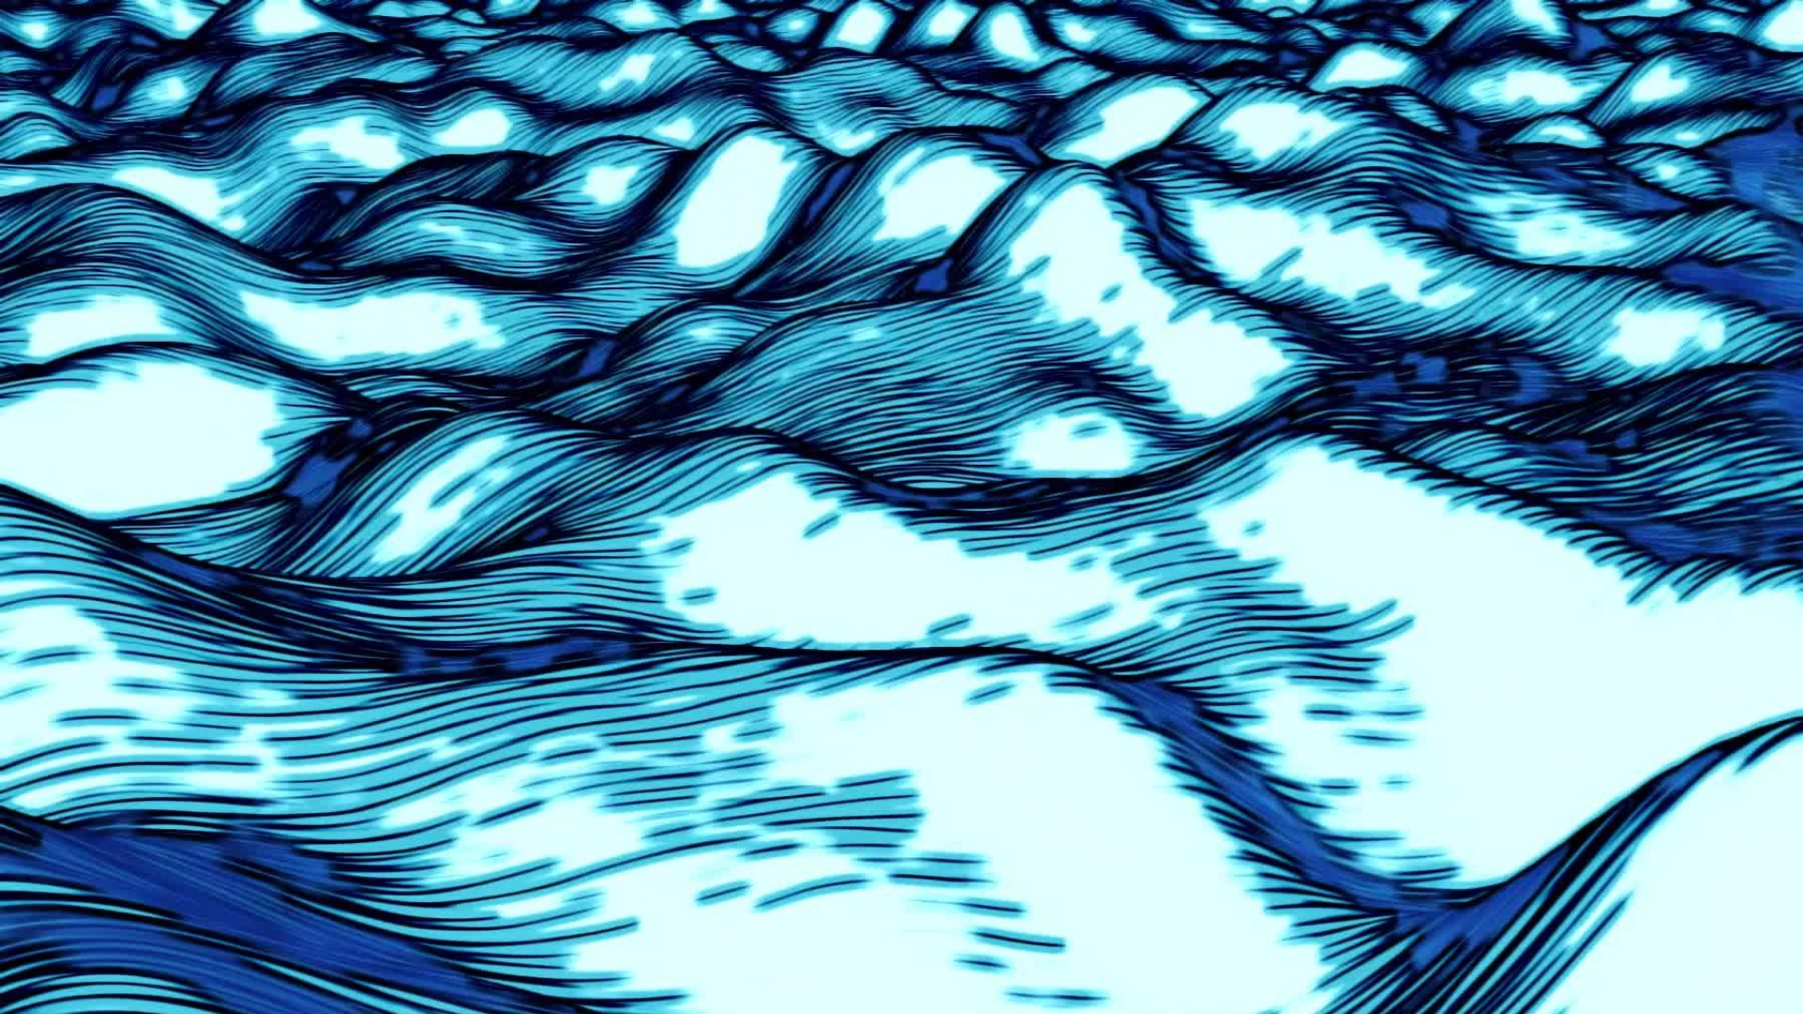
TIDAL enERGY
David Blanco López

Slide 2
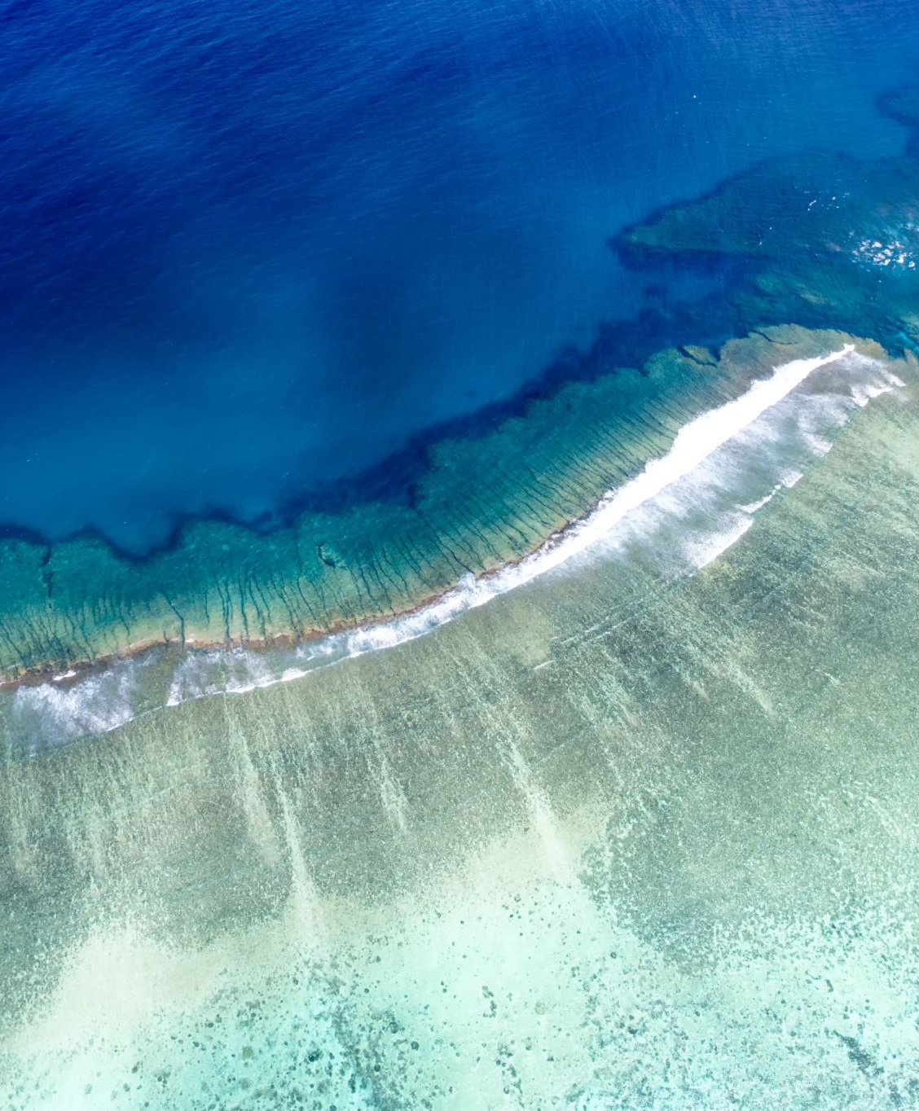
Definition: tidal energy is a type of renewable energy generated by using the natural rise and fall of ocean tides to produce electricity.

Slide 3

History:
Tidal energy began centuries ago using wooden mills to grind grain with the ocean´s movement. Today, we use high-tech underwater turbines to turn tides into clean, predictable electricity for our homes.

Slide 4

How it works:
Underwater turbines work like windmills, but use moving ocean waterinsteadof air to spin their blades. That spinning motion in a generator transforms water energy into clean electricity.

Slide 5
Main Countries
South Korea
France
United Kingdom

Slide 6
