Slide 1

ROCOCO STYLE
"The Bath of Diana" by François Boucher

Slide 2
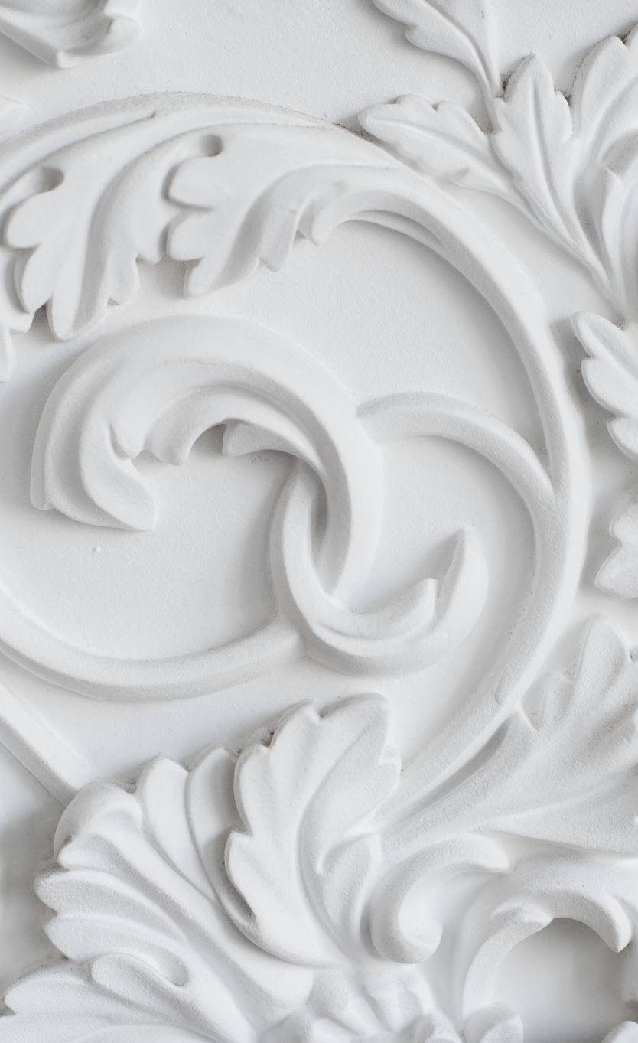
What's rococo?
Rococo is an art style that appeared in France in the 18th century. It came after the Baroque, but instead of being serious and dramatic, Rococo wanted to be light, fun and decorative. It was a style used by the rich people of the time, who liked art that looked beautiful, sweet and full of details.
The main ideas of Rococo are:
Pastel colors, like pink, light blue and cream
Curvy shapes and lots of decoration
Romantic and playful themes
Scenes from mythology, but shown in a soft and pretty way
Nature as something peaceful and perfect
A general feeling of delicacy, elegance and charm
Rococo paintings usually try to make the viewer feel good, like entering a small fantasy world full of beauty.

Slide 3
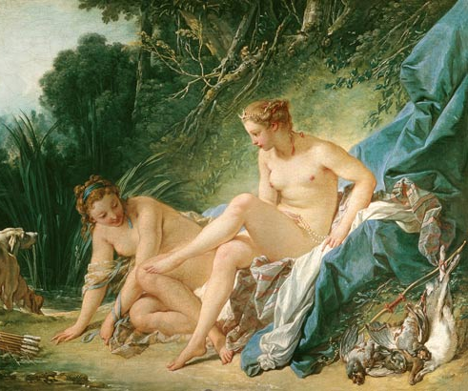
The bath of diana
The Bath of Diana shows Diana, the Roman goddess of the hunt, getting ready to take a bath. She is surrounded by her nymphs, who are helping her with her clothes and taking care of her things. The girls appear calm, pretty and very elegant.
The light in the painting is soft, and the colors are mostly light pinks, creams and gentle greens. The landscape looks perfect and peaceful, almost like a dream. Diana and the nymphs have smooth skin and relaxed poses, which makes the whole scene feel quiet and magical.
Every detail, like the fabric, the leaves and the animals, is painted in a delicate way. Because of this, the painting feels very decorative and beautiful to look at.

Slide 4
Why is this painting rococo?
WHY THIS PAINTING IS ROCOCO
This artwork is Rococo because:
It uses light, pastel colors.
It shows a mythological scene, but not in a serious way. Instead, it is soft and beautiful.
The figures are painted with curvy lines, making them look elegant and delicate.
The painting focuses on beauty and charm, not on action or drama.
The whole scene feels like a romantic fantasy, which is exactly what Rococo artists loved to create.

Slide 5
conclusion
CONCLUSION
The Bath of Diana is a very good example of Rococo because it shows everything that makes this style special: beauty, softness, decoration and a dreamy atmosphere. François Boucher creates a world that feels elegant and peaceful, just like the Rococo style wanted.

