Slide 1
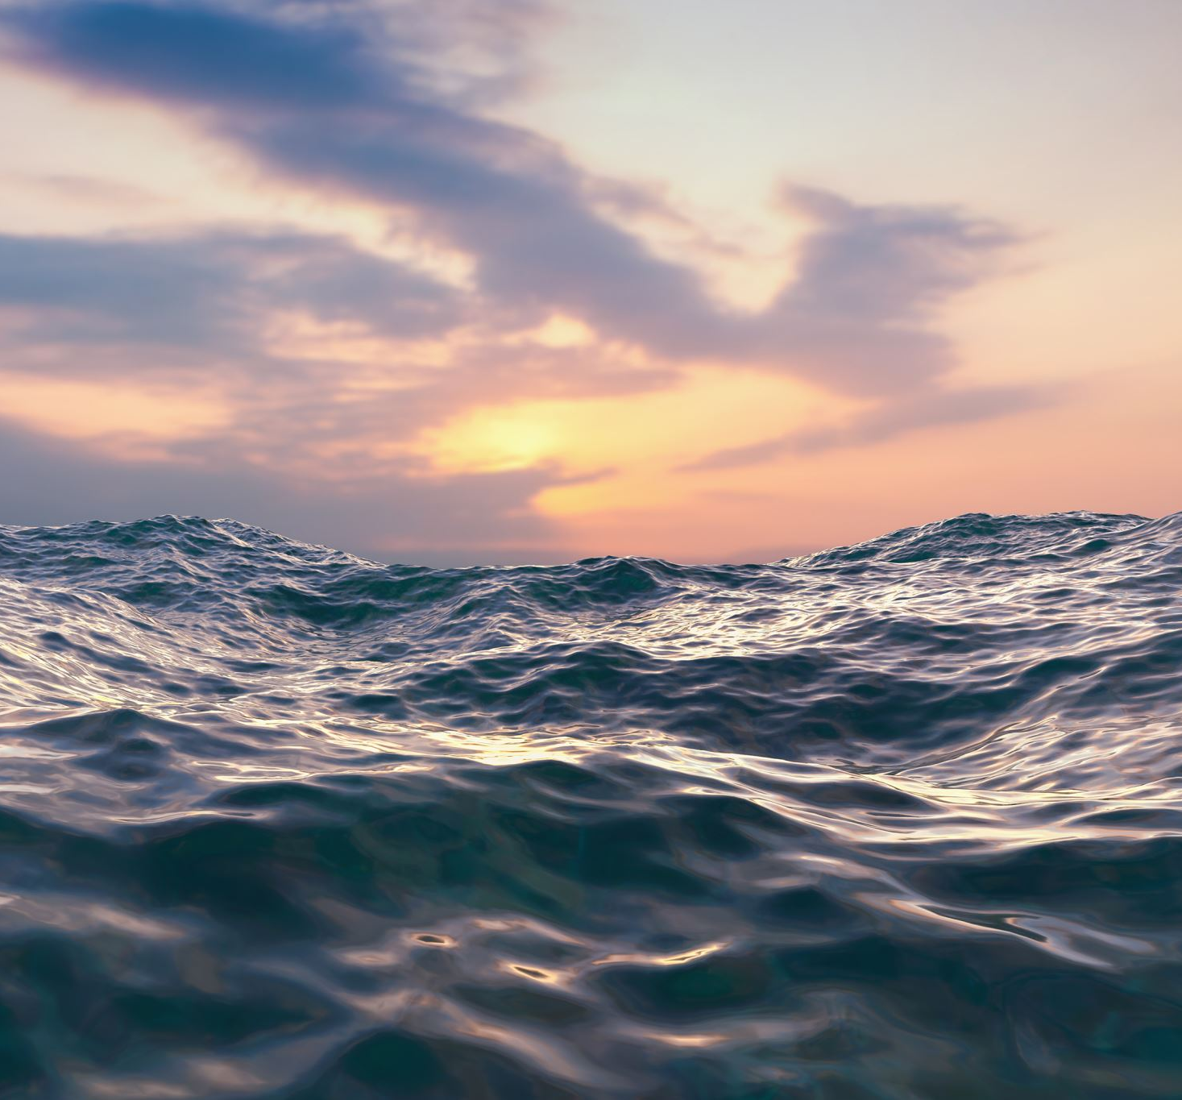
OCEAN ENERGY
Aya el fahim

Slide 2
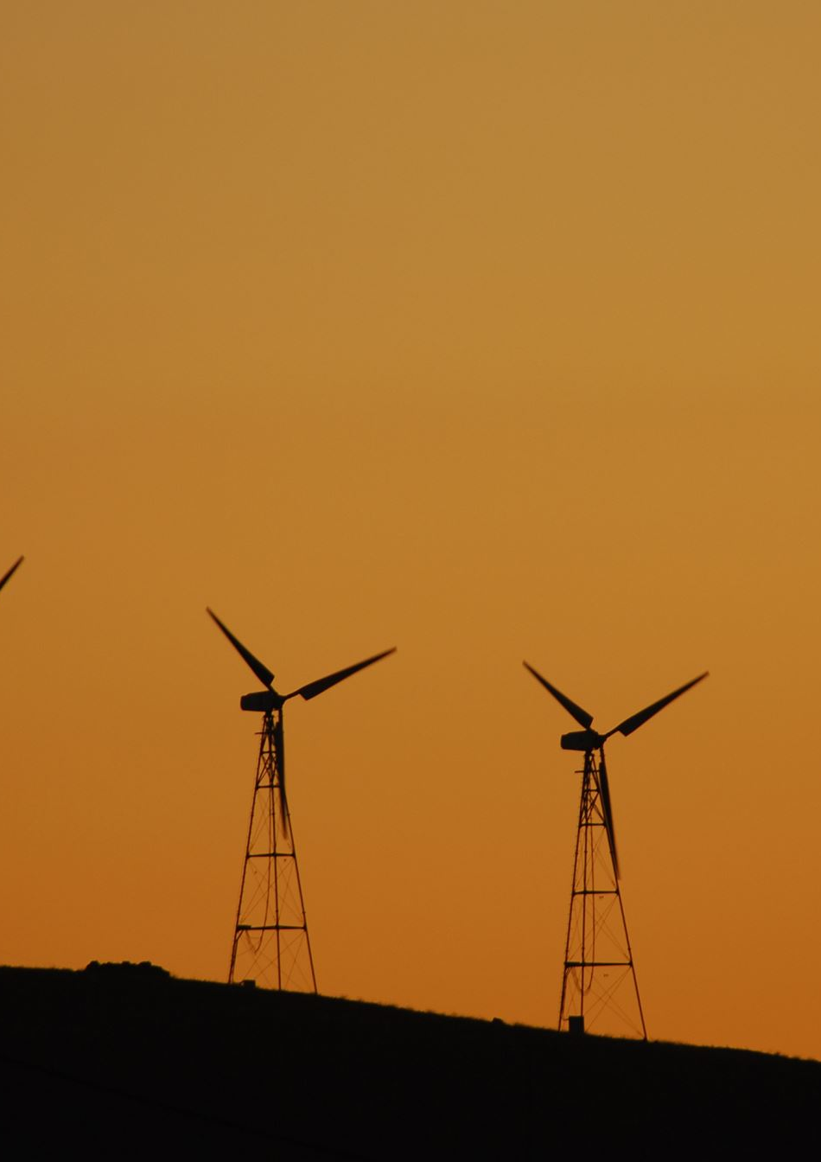
Defenicion of ocean energy
Marine energy refers to a set of technologies that harness the energy of the oceans. The sea has enormous energy potential, manifested primarily in waves, tides, currents, and the temperature difference between the surface and the seabed.

Slide 3
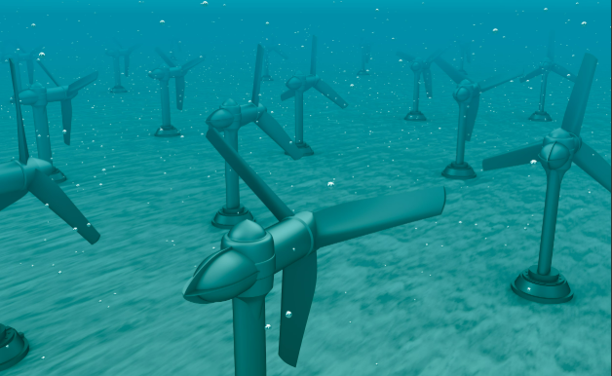
Historical overview and how it works
-Humans have harnessed the power of the tides, and in Europe during the Middle Ages, tidal mills used the rise and fall of the sea to move wheels and grind grain.
-With technological development, the first experimental tidal power plants emerged. In 1966, the La Rance tidal power plant (France) was built.

Slide 4
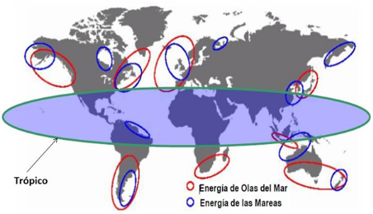
The main countries that produce this energy
Europe is a world leader in this sector, with European companies holding around 23% of patents. Countries like the United Kingdom and France stand out in its development, along with other countries such as South Korea, Canada, and China, although its use is still limited.

Slide 5
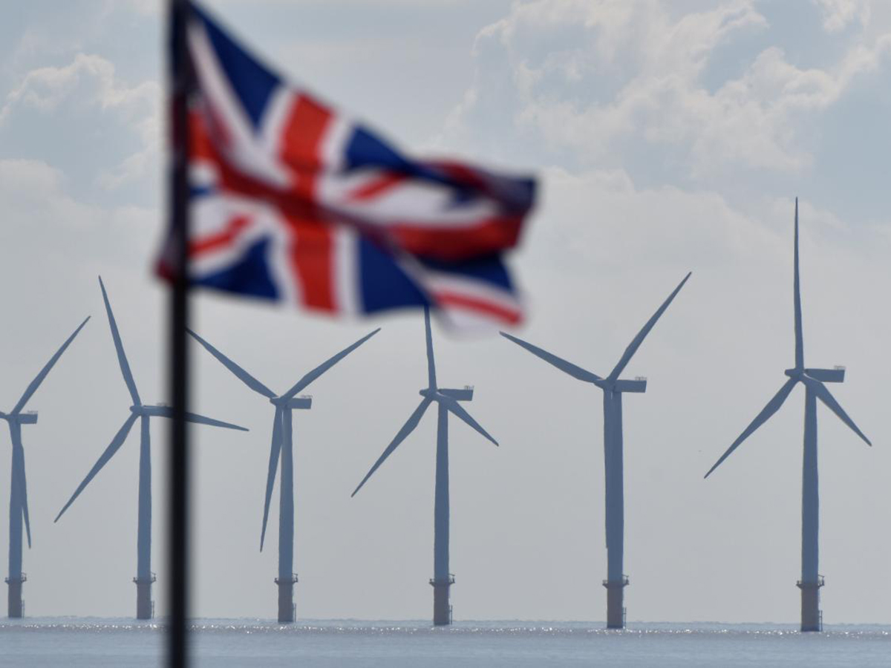
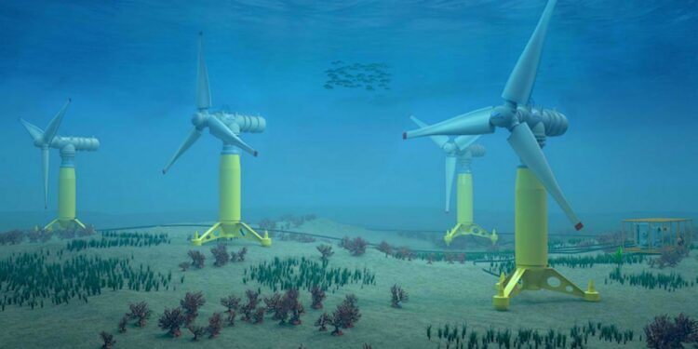
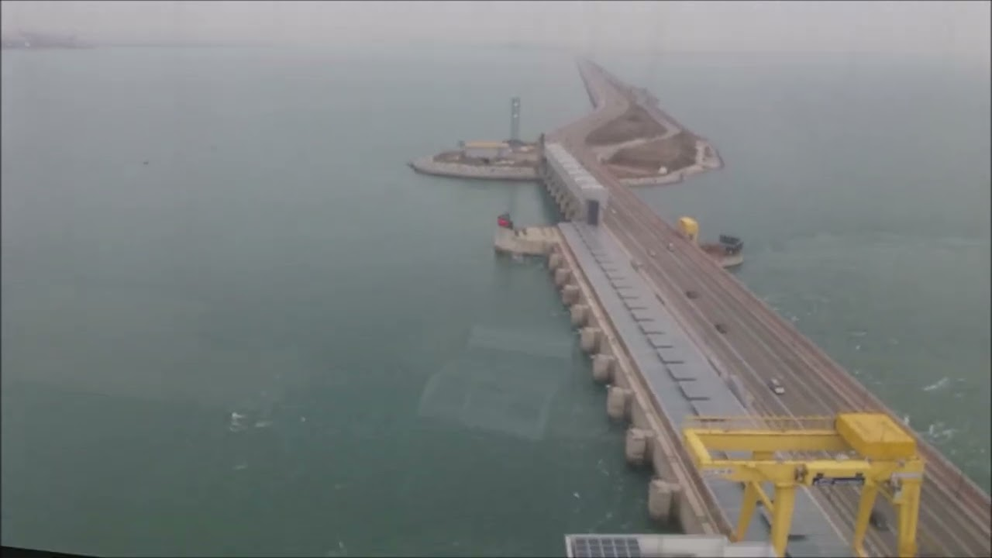
These are some sites with ocean energy
United Kingdom
France
South Korea

