Slide 1
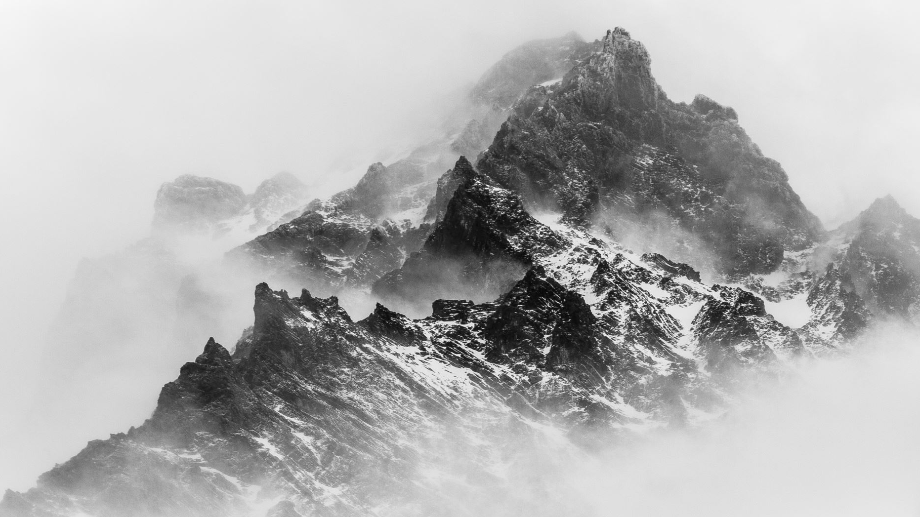
Kingom of Leon
By Noé García

Slide 2
What the Kingdom of Leon was?
It was one of the most important Cristian Kindoms.
It lasted three centuries: X-XIII.

Slide 3
How the Kingdom of Leon was created?
Was created in the IX century in 854.
They change the capital from Oviedo to Leon.
This became to change the name of the kingdom.

Slide 4
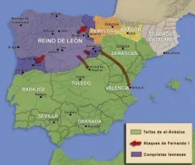
How the Kingdom of Leon grew?
During the next centuries they repoblated the the north of the river Ebro.

Slide 5
Who were the most importants kings?
Alfonso III: who led to create the Kingdom of Leon.
Ordoño II: he fought against the Muslims.
Alfonso V: he created the Fueros of Leon.
Alfonso IX: he called Cortes of Leon the first parliament in Europe.
Urraca I: she was queen by herself during 1109-1126

Slide 6
Cortes of Leon
Bourgoisie could participate in the Cortes that was something new.
It was important because all the priviledge people had to listen to non-priviledge and don't govern alone.
It were held by Basilica of San Isidoro, the first Corte was at 1188.

Slide 7
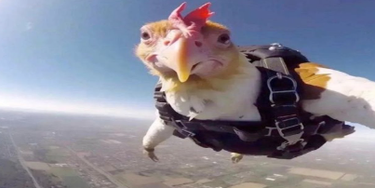
THANKS FOR VIEW

