Slide 1
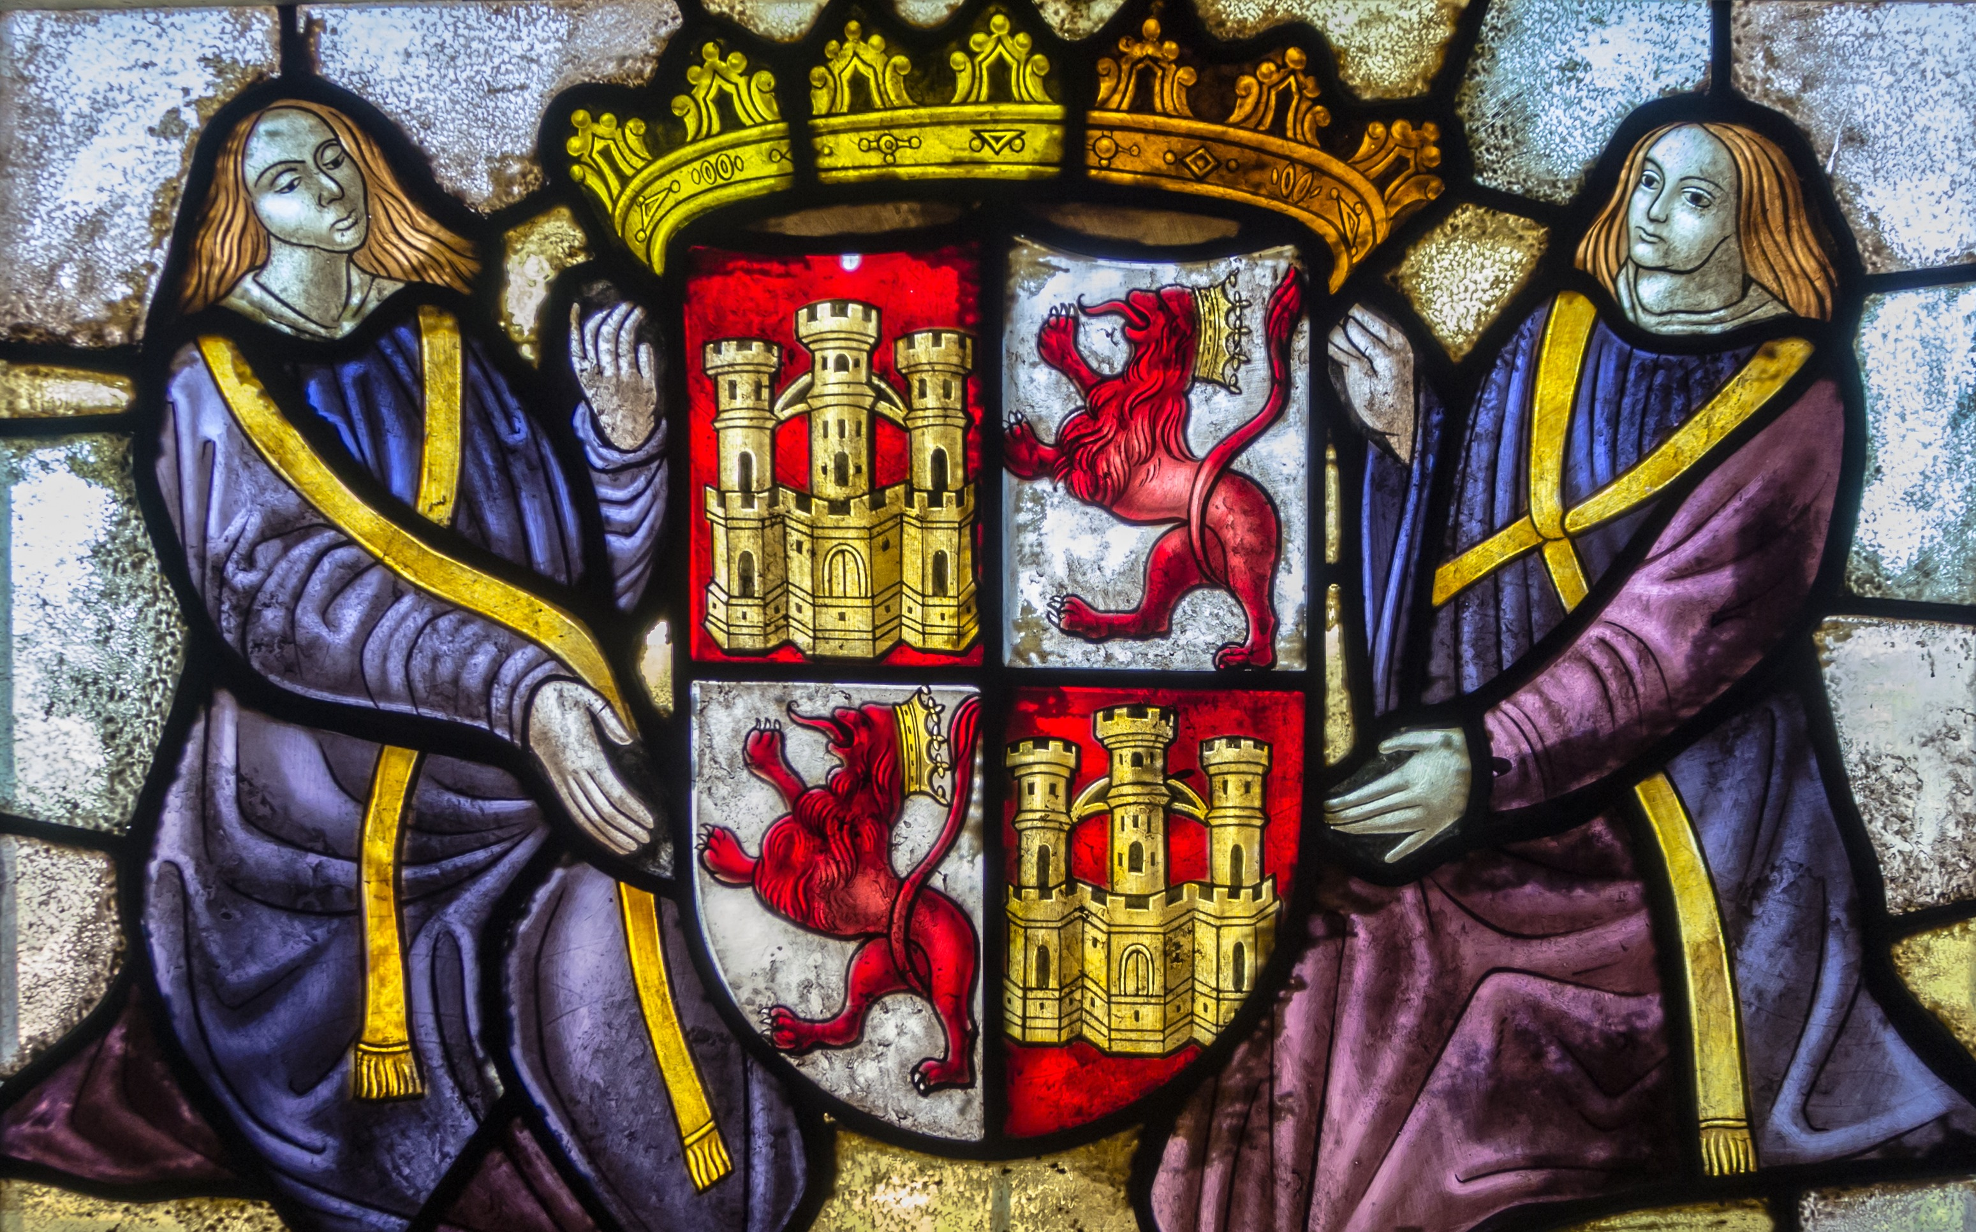
KINDOM OF CASTILLA
By Adam Khoubi Mahrach

Slide 2
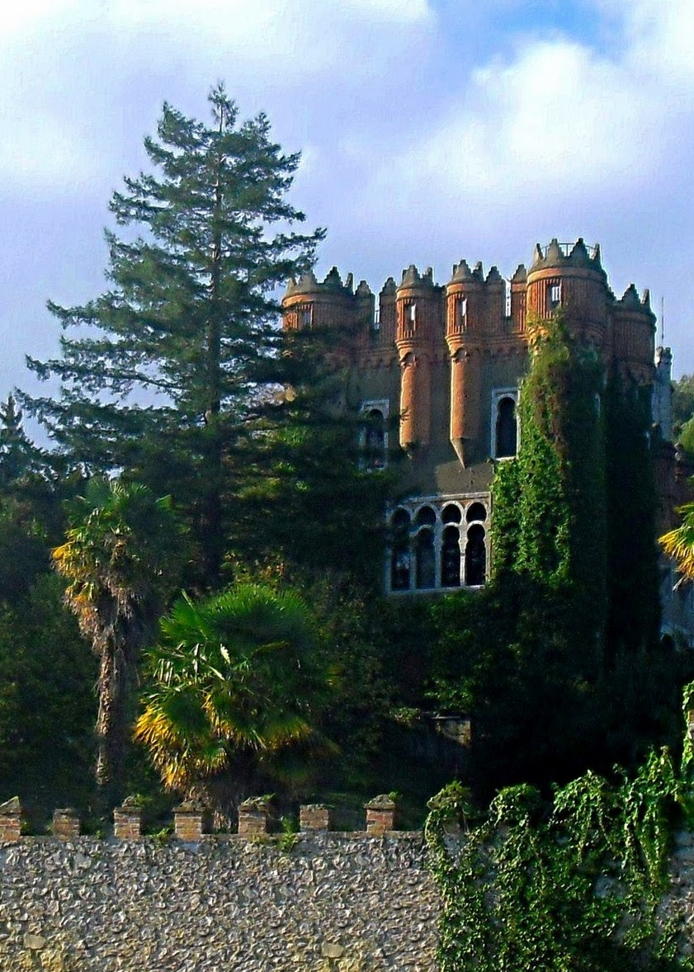
Index:
1. The monarchy
1.1How it was?
1.2 Why was powerful?
1.3 What is the Royal Council
2. The cortes
2.1 Who created them?
2.2 When was created?
3. The municiplates
3.1 for what thing the consejos change for?

Slide 3
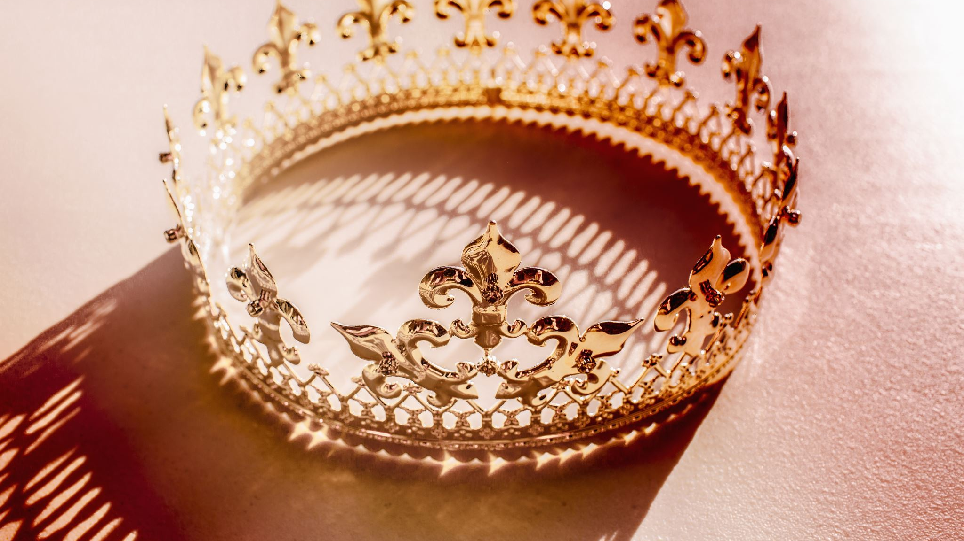
Monarchy, what was it like?

Slide 4
The Kindom of Castilla was the must powerful institution.It made laws, declared wars, delivered justice, and colleted taxes.

Slide 5

1.2 why was powerful?

Slide 6
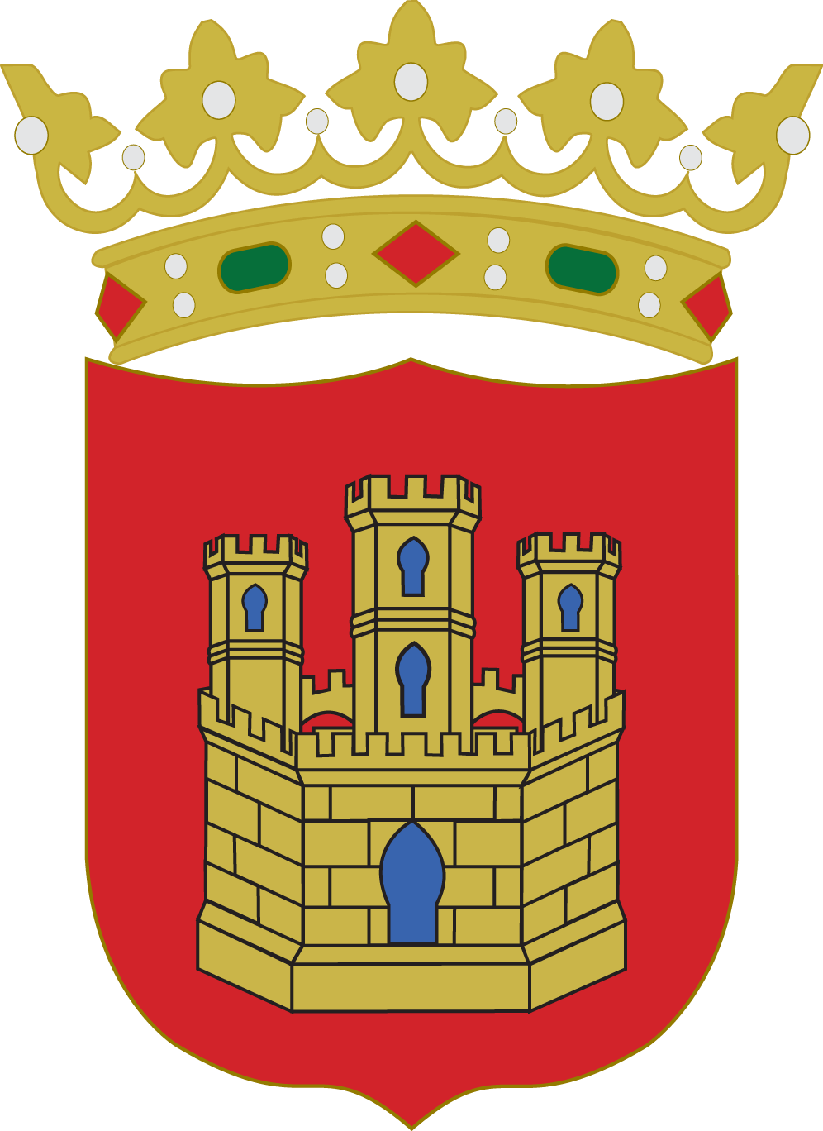
It was more powerful than others because of a series of measures:
The Royal Councils

Slide 7

1.3 What is the Royal Council?

Slide 8
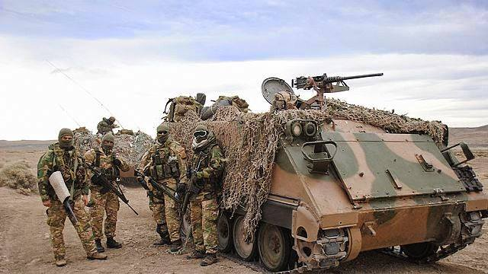
This is an increase number of mercenary soldiers the and the creation of istitutions such as the royal council the court of justice and cancellery.

Slide 9
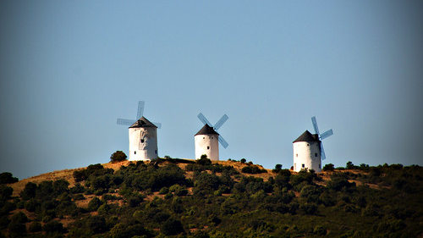
2. The Cortes

Slide 10
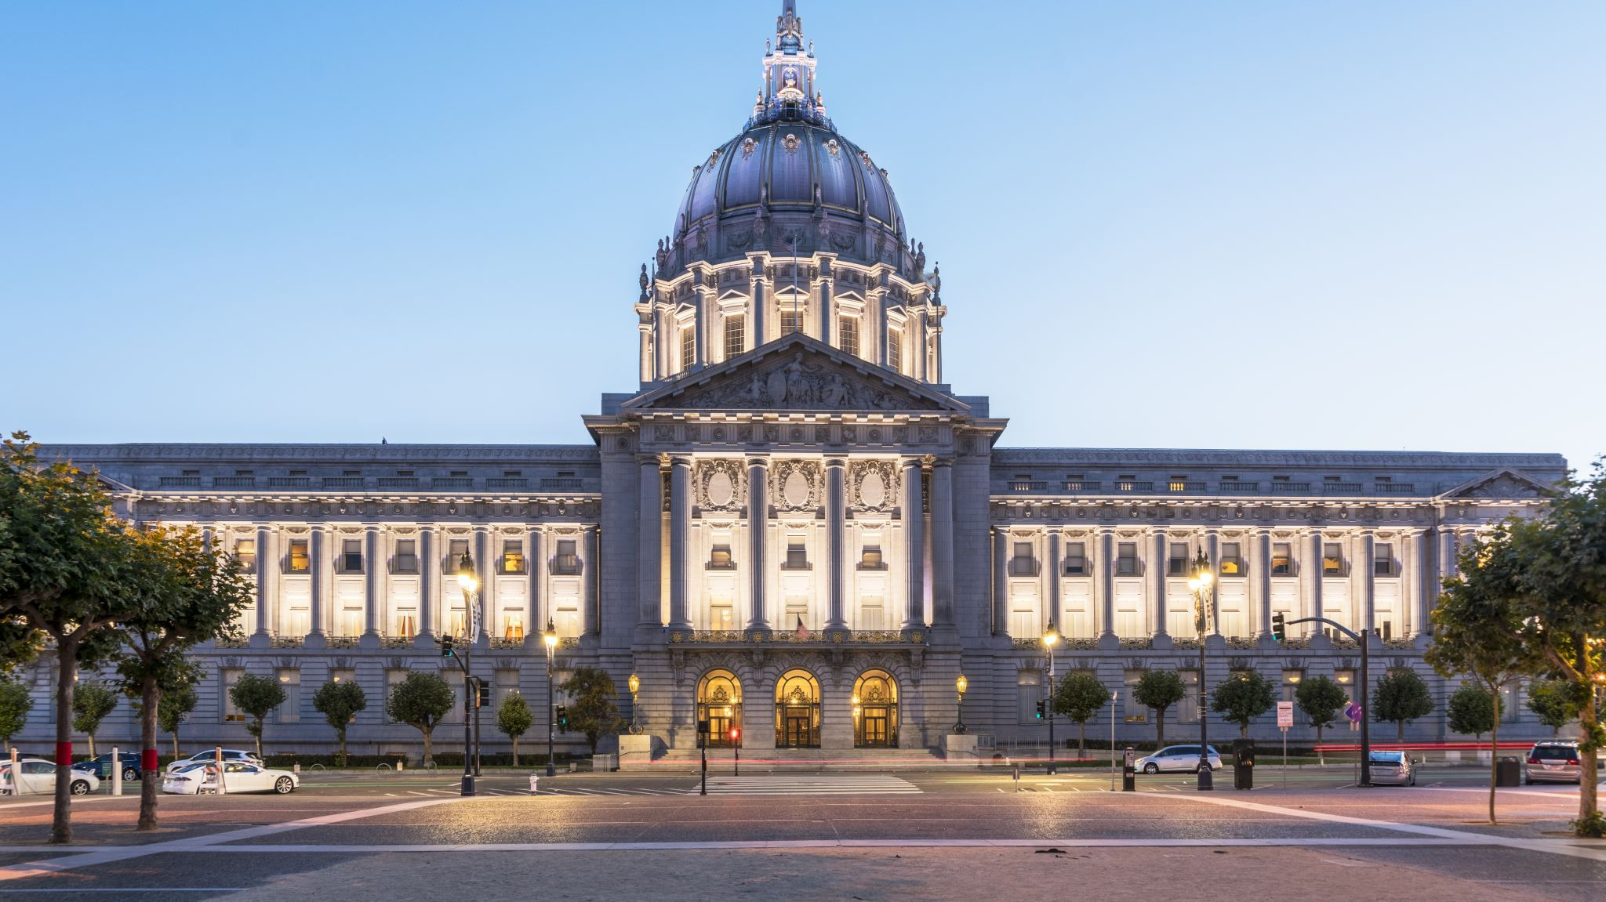
There Cortes (the Parlamento)
were the main consultative bodies. They
Hadrepresenttives from nobility, cleregy & cities.

Slide 11
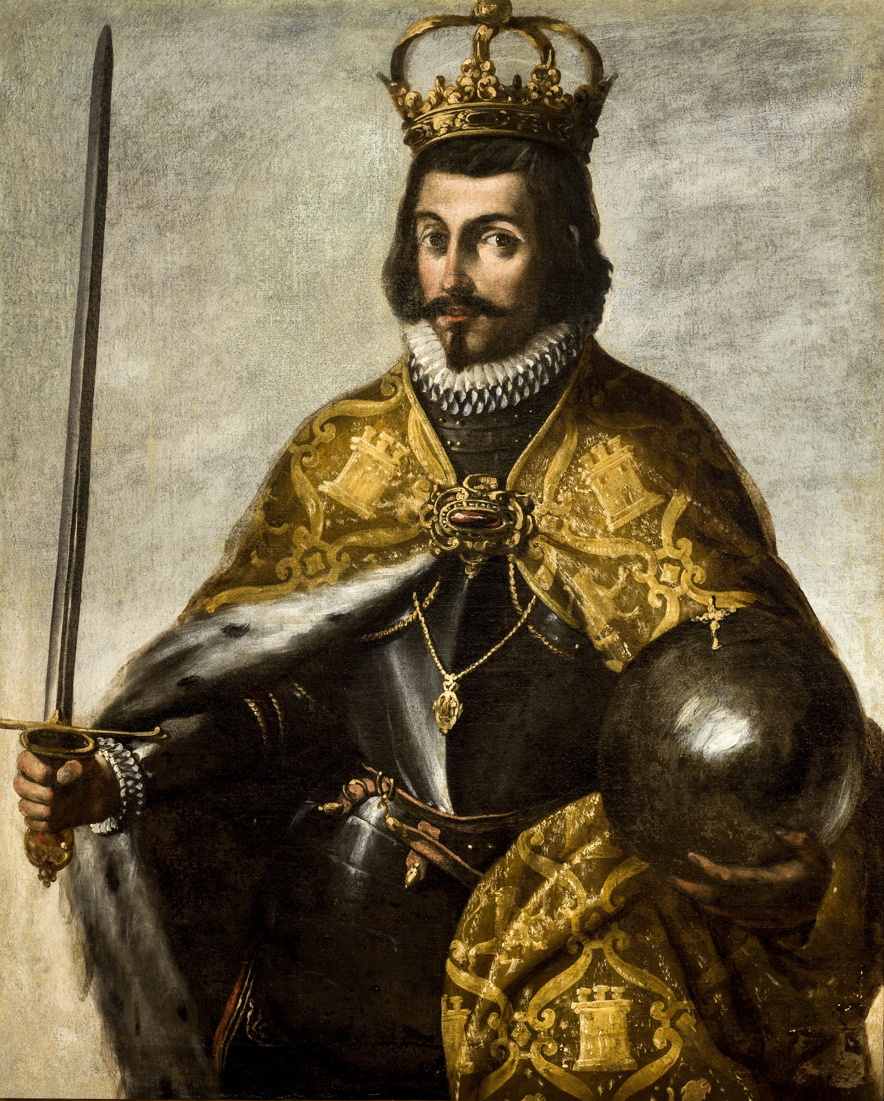
Who created them?

Slide 12
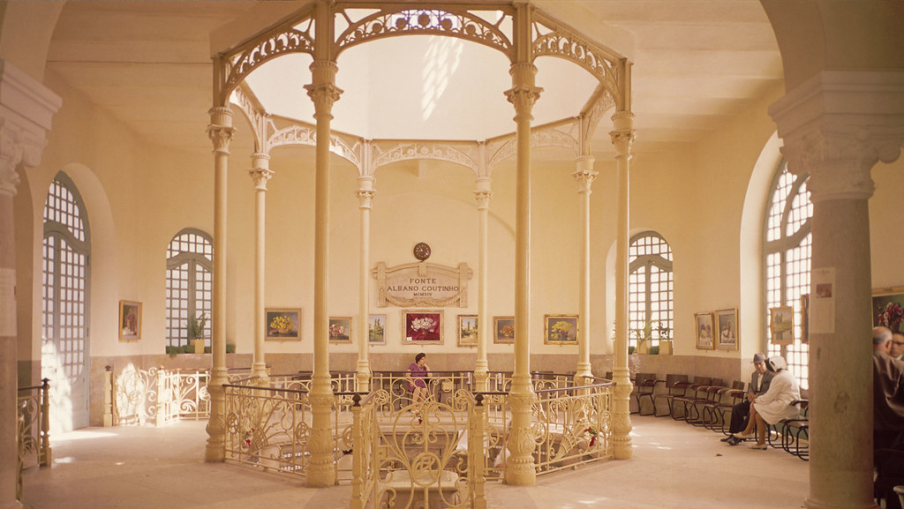
They were created when the Monarch (King Alfonso IX of León in the spring of 1188)allowed city representatives into Curia, an assembly of nobes and clergy.
Curia: The set of congregations and tribunals that exist in the court of the Roman Pontiff for the governance of the Catholic Church.

Slide 13

When was created?

Slide 14
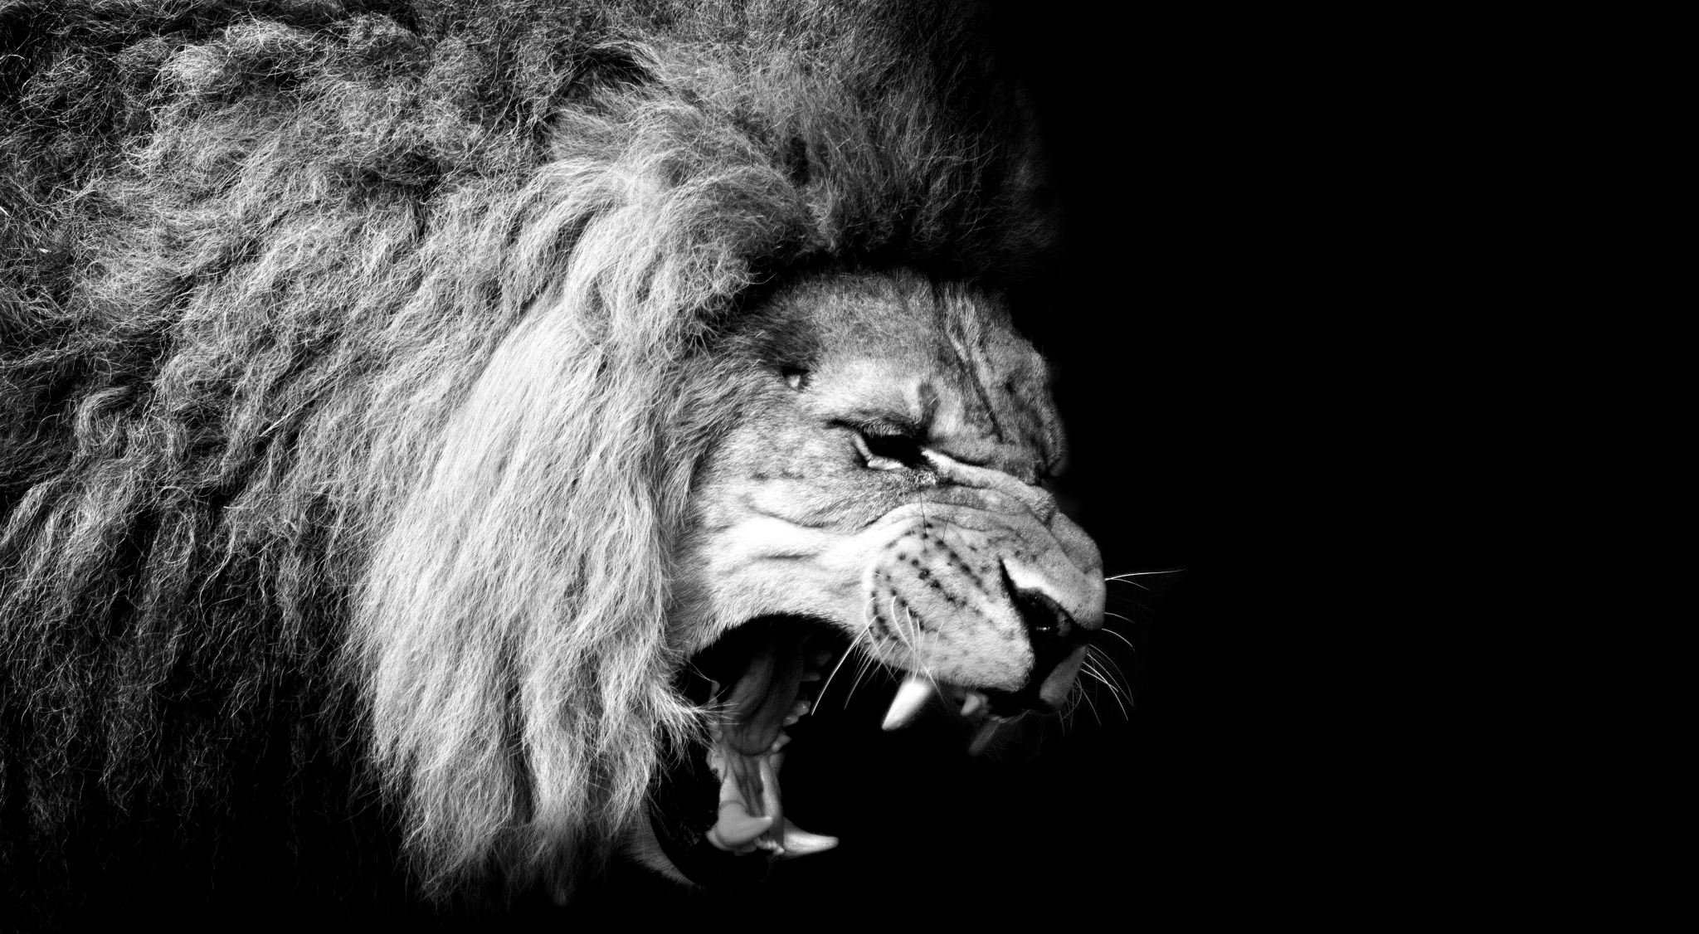
The creation of Cortes Of Castilla not far away of the Cortes of león.
Cortes of castila was created in 1250 ( XIII), And the cortes of león was created in 1188 (XIX).

Slide 15
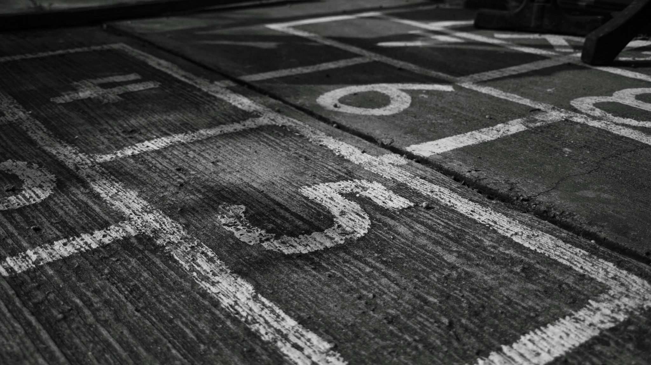
3. The municiplates

Slide 16

Cities were initially
governed by consejos
(meetings of residents).

Slide 17

3.1 for what thing the consejos change for?

Slide 18

Over time, the consejos were replaced by cabildos, whose members were mostly appointed by the king and for life.

Slide 19

Pls Lucía this is a very well done presentation it deserves a 10 .

