Slide 1
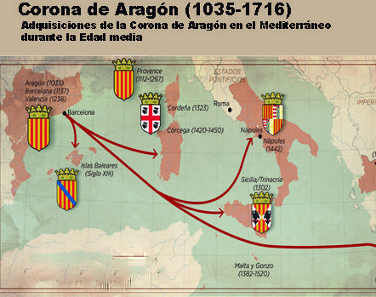
The Crown Of Aragon

Slide 2
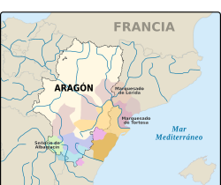
Territories
Consisted of three territories (Aragon, Catalonia and Valencia).
Each had its own laws and institution, but they had the same monarch.

Slide 3
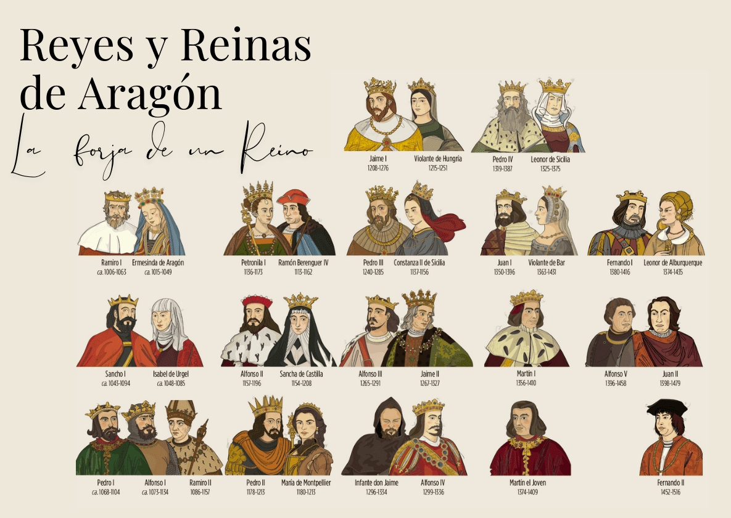
Monarchs
Monarchs had to swear an cath to respect the fueros of each territory,reach agreements whit the Cortes.

Slide 4
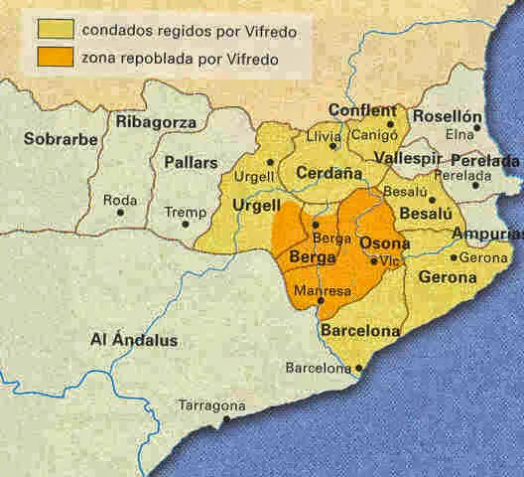
Catalonia Counties
Each territory had its own Courts, which voted on laws and types.
Each territorys also had a Diputacion General or Generalitat, which had executive powers.

Slide 5
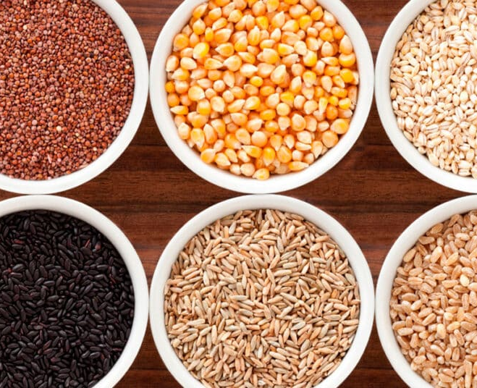
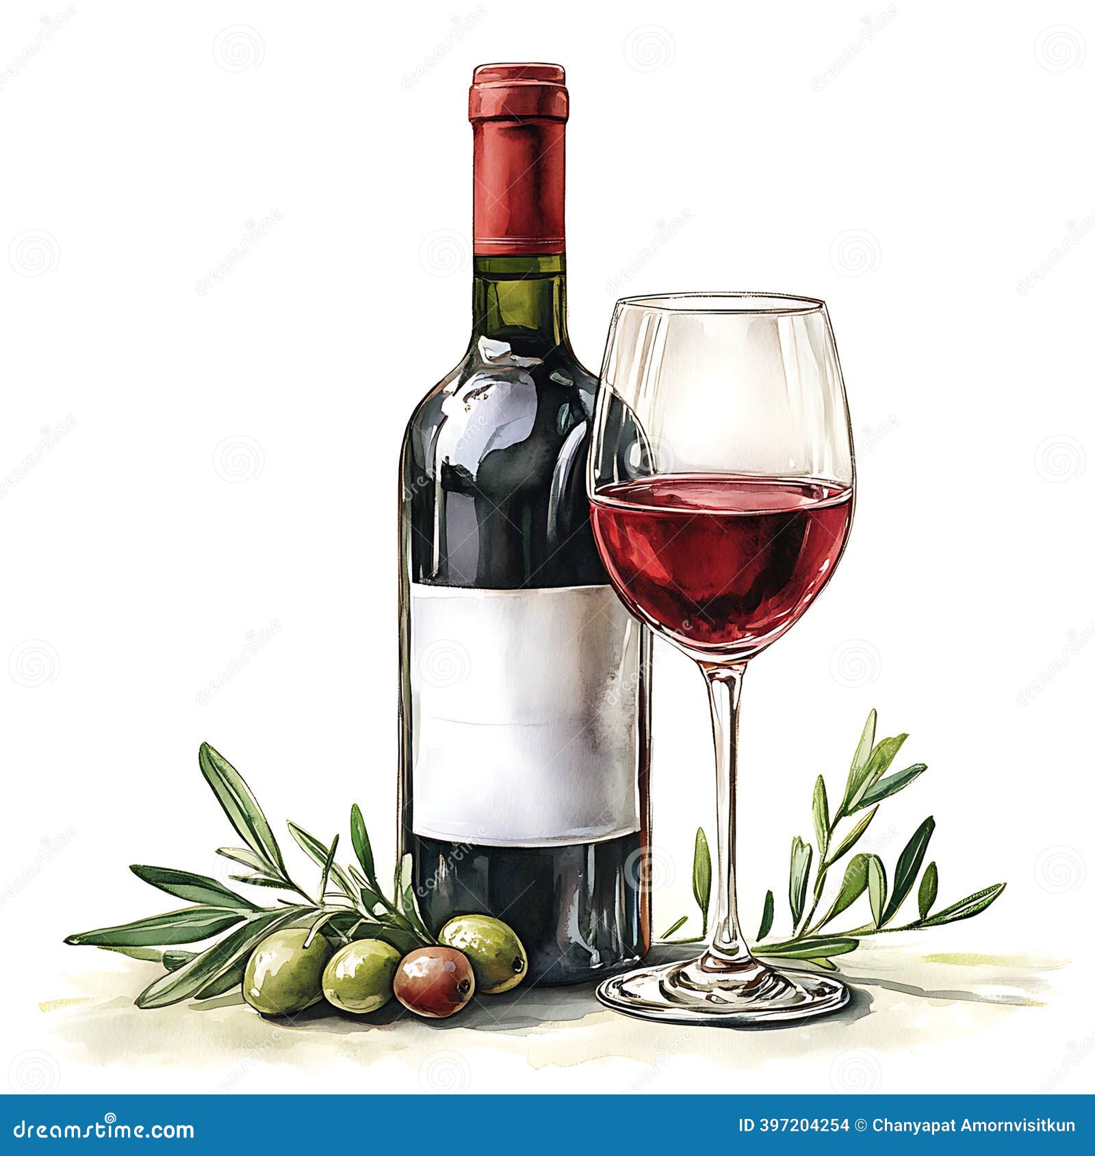
Agricultural and comercial economy
Economy was based on arable and livestok farming (cereal, vines and olives) fruit vegetables sheep farming mediterranean trade led to economic prosperity.

Slide 6
Thank you for your attencion theacher

